Slide 1
Public Open House Meeting
LAKE HAVASU CITY Second Bridge Feasibility Study
January 29, 2024

Slide 2
Introduction
Michael Baker International Team – Top 5 Bridge Consulting Firm
Tony Cabrera, PE – Project Manager
Russell Moore, PE – Senior Roadway Design Engineer Lead
Tom Ritz, PE - Bridge Engineer Lead
Kevin Kugler, AICP – Transportation Planner/Public Engagement Lead
Zsalina Allen - Project Planner
Supporting Team Members
Kevin Murphy, PE, NV5
Kittelson & Associates
Notes:
Tony – 39 years of roadway and bridge design experiences – has designed 35+ joint bridge/roadway projects
Russ – 40 years of roadway and bridge design experiences
Tom – 30 plus years of experiences leading design and inspections
Kevin K – 30 + years experience leading community and transportation studies/projects throughout Arizona
Kevin Murphy – former City PW Director and with 30 years engineering design experience – knows LHC well!

Slide 3
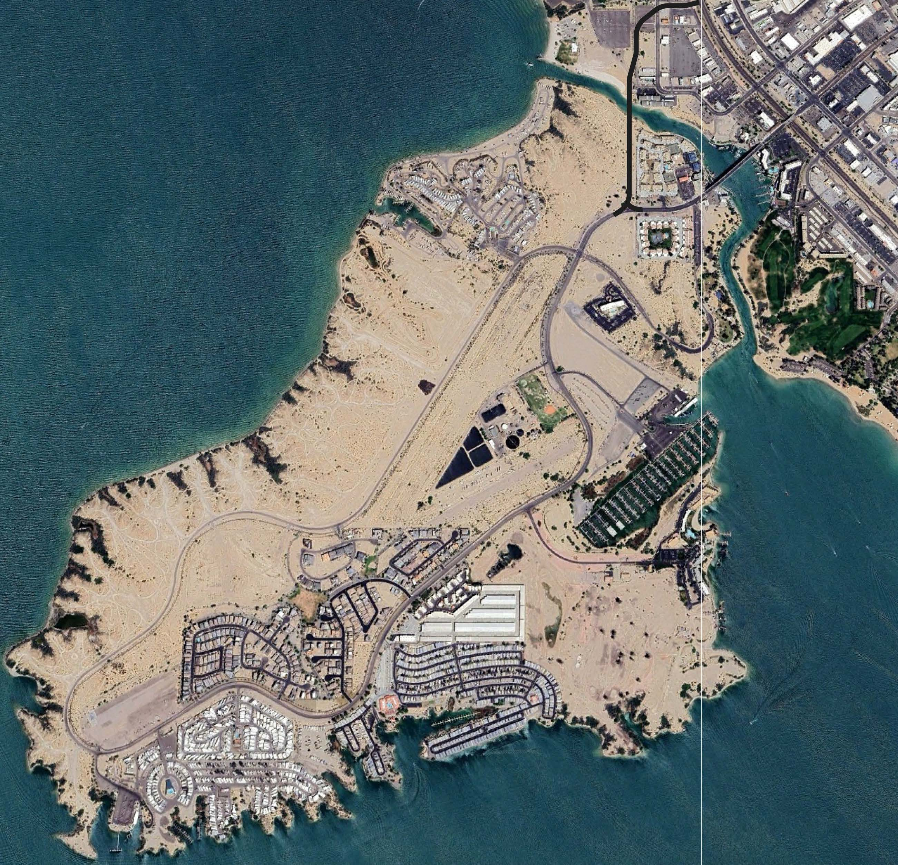
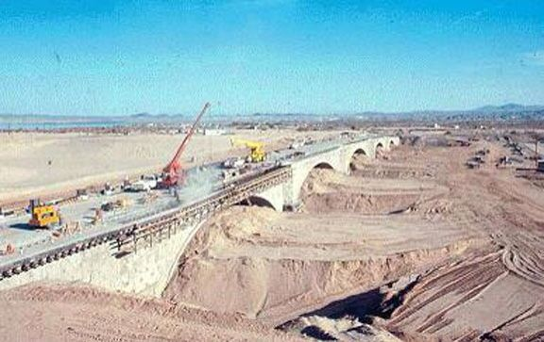
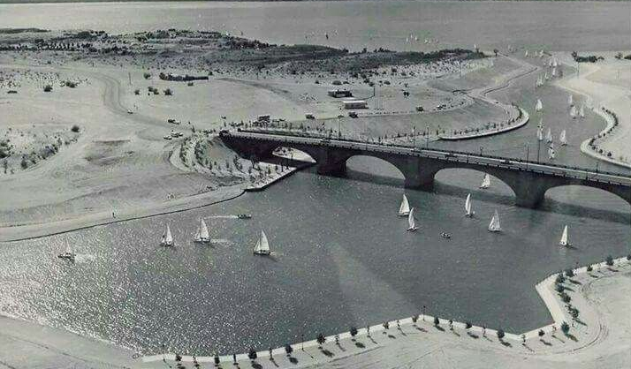
Background/History – This Concept is Not New!
ASP
Notes:
There are a lot of opportunities

Slide 4
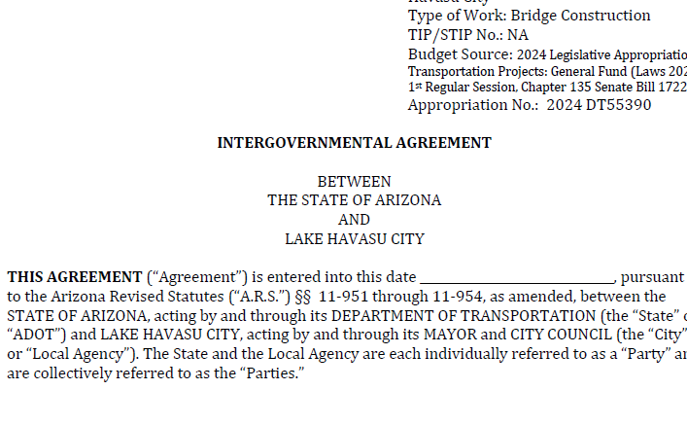
Background/History
Lake Havasu City has entered into an Intergovernmental Agreement with the State of Arizona (ADOT) to accept the state-appropriated funding of $35,500,000 for the study, design and construction of an emergency evacuation route second bridge.
This Feasibility Study is the first step in this process, as required
by SB 1722.

Slide 5
Background/History
Lake Havasu City has also entered into Memorandums of Understanding (MOU) with the Arizona State Parks Board (1997 & 2019) to exchange properties for the improvement of Lake Havasu State Park and reserve right-or-way across Parks property for a future roadway approach and second bridge.

Slide 6
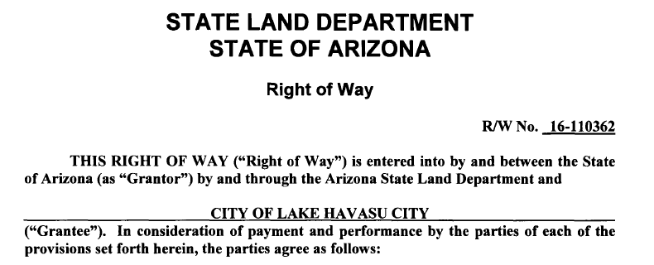
Background/History
Lake Havasu City has also entered into an agreement (2007) with the Arizona State Land Department to obtain right-of-way for the improvement of a roadway and utilities across ASLD lands on the island.

Slide 7
Second Bridge Feasibility Study Purpose
To meet the legislative requirements of SB 1722 (55th Legislature) by conducting a feasibility study to analyze and recommend preliminary design options and cost estimates for a second bridge and roadway approaches in advance of the design and construction of these improvements, as authorized and funded by the Arizona Legislature.
Notes:
Now, this is not your typical approach to a project like this, and LHC is fortunate to have proactive representation at the state capitol to obtain important funding in advance of the design and construction of this project. Rep Biasucci was instrumental in the success in obtaining this funding and we are here to carry forward the requirements and the process leading up to the eventual construction of the second bridge.

Slide 8
Second Bridge Feasibility Study Considerations
Enhance Public Safety including identification of an emergency evacuation route
Improve Traffic Operations/Reduce Congestion at Peak Periods
Develop, analyze and report on roadway and bridge alternative concepts, including:
Bridge Structure Type/Architecture
Roadway Approach Concepts/Alternatives
Bridgewater Channel Impacts
Public/Stakeholder Input
Environmental Overview (high level)
Utility Conflicts
Minimize Impacts to Adjacent Property Owners
Multimodal Operations/Infrastructure
Notes:
Structure and bridge type – to complement, not to compete with or outshine the London Bridge!

Slide 9
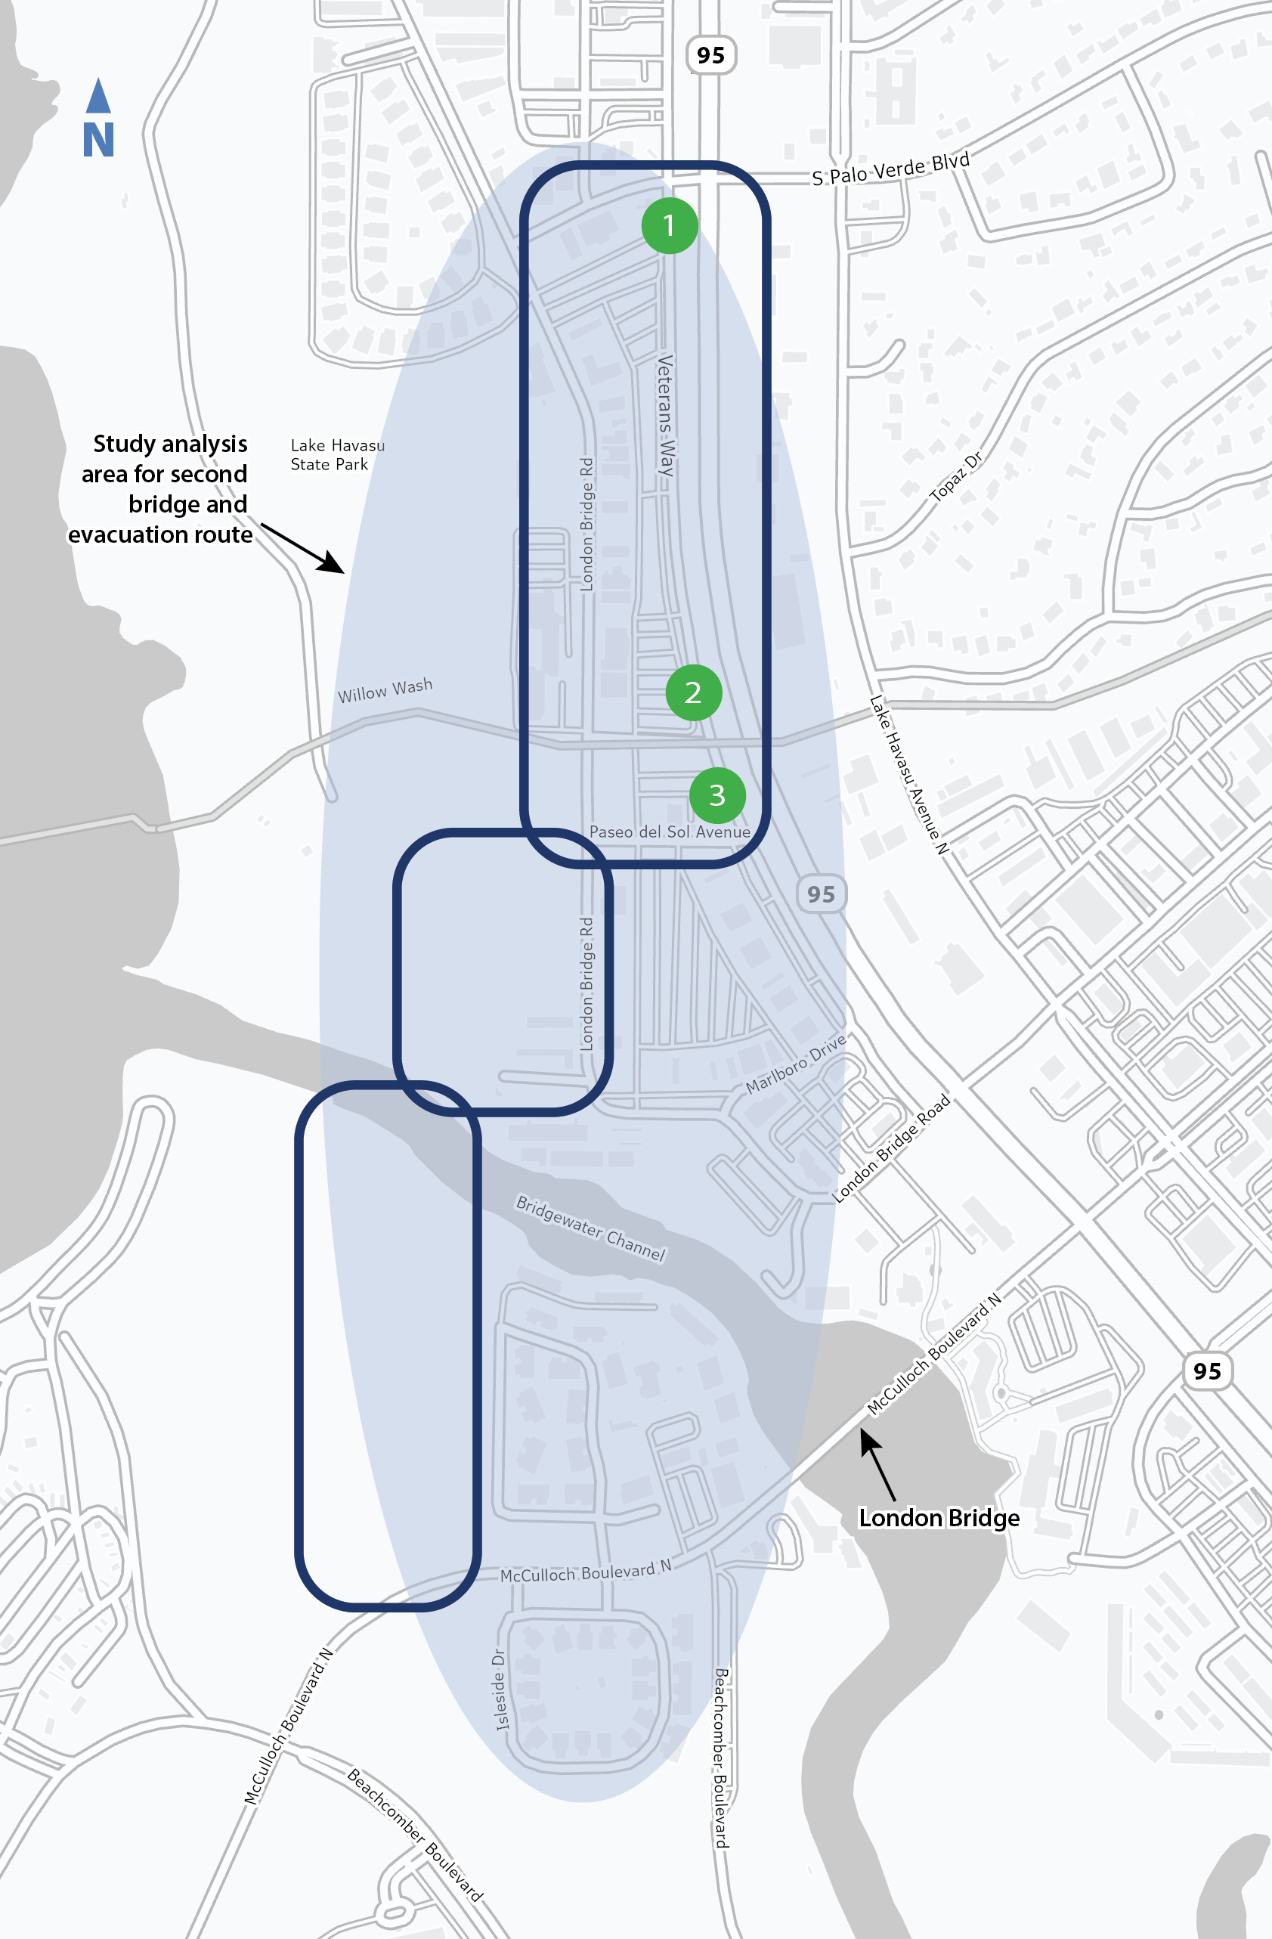
Study Area Components
US 95 Connection
Palo Verde Blvd.
Willow Wash
Paseo del Sol Ave.
Roadway Approach
Transition area; existing roadways to new roadway alignment
Bridge Crossing + Island Roadway
Bridgewater Channel bridge crossing
New island roadway alignment and connection to McCulloch Blvd.
US 95 Connection
Roadway Approach
Bridge Crossing +
Island Roadway

Slide 10
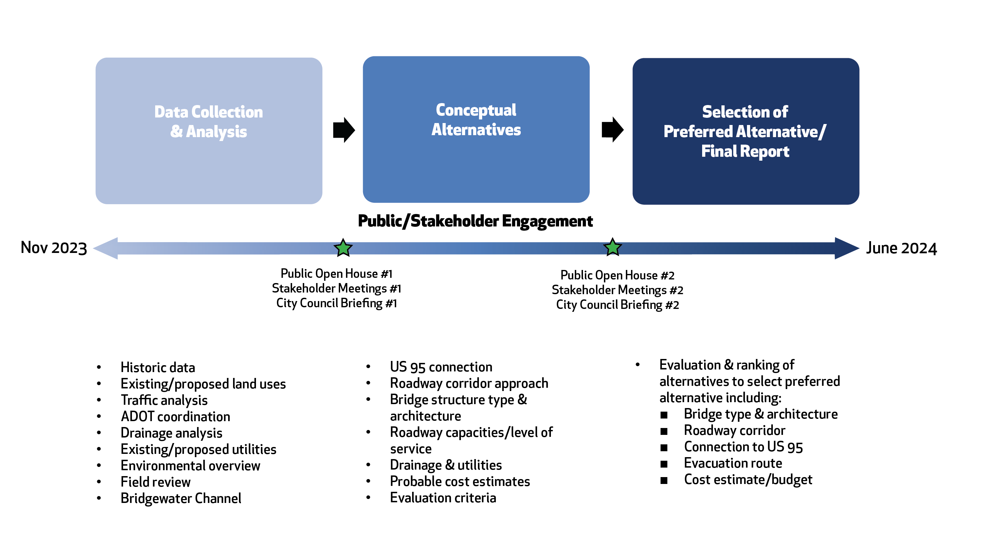
Second Bridge Feasibility Study Process

Slide 11
Group Feedback & Discussion
There are a few ways you can provide your feedback to the study team:
Fill out your comment cards tonight and place them into the comment card basket.
Use the QR code to complete your comment card electronically, at home, at your convenience. Comment period will close end of day, February 13th.
Your feedback will be documented and included in the Second Bridge Feasibility Study Final Report!

Slide 12
Second Bridge Feasibility Study: Next Steps
Collect Your Comments!
Stakeholder Meetings – to be scheduled in February
City Council Project Briefing
Traffic Analysis
Roadway and Utility Analysis
Preparation of the Conceptual Alternatives

Slide 13
Second Bridge Feasibility Study
THANK YOU FOR ATTENDING!
Please provide your comment card feedback by February 13, 2024
For any additional questions, please contact:

